Slide 1
Predicting remaining useful life of turbofan engines
Infrastructure Diagram and Model Explainability

Slide 2
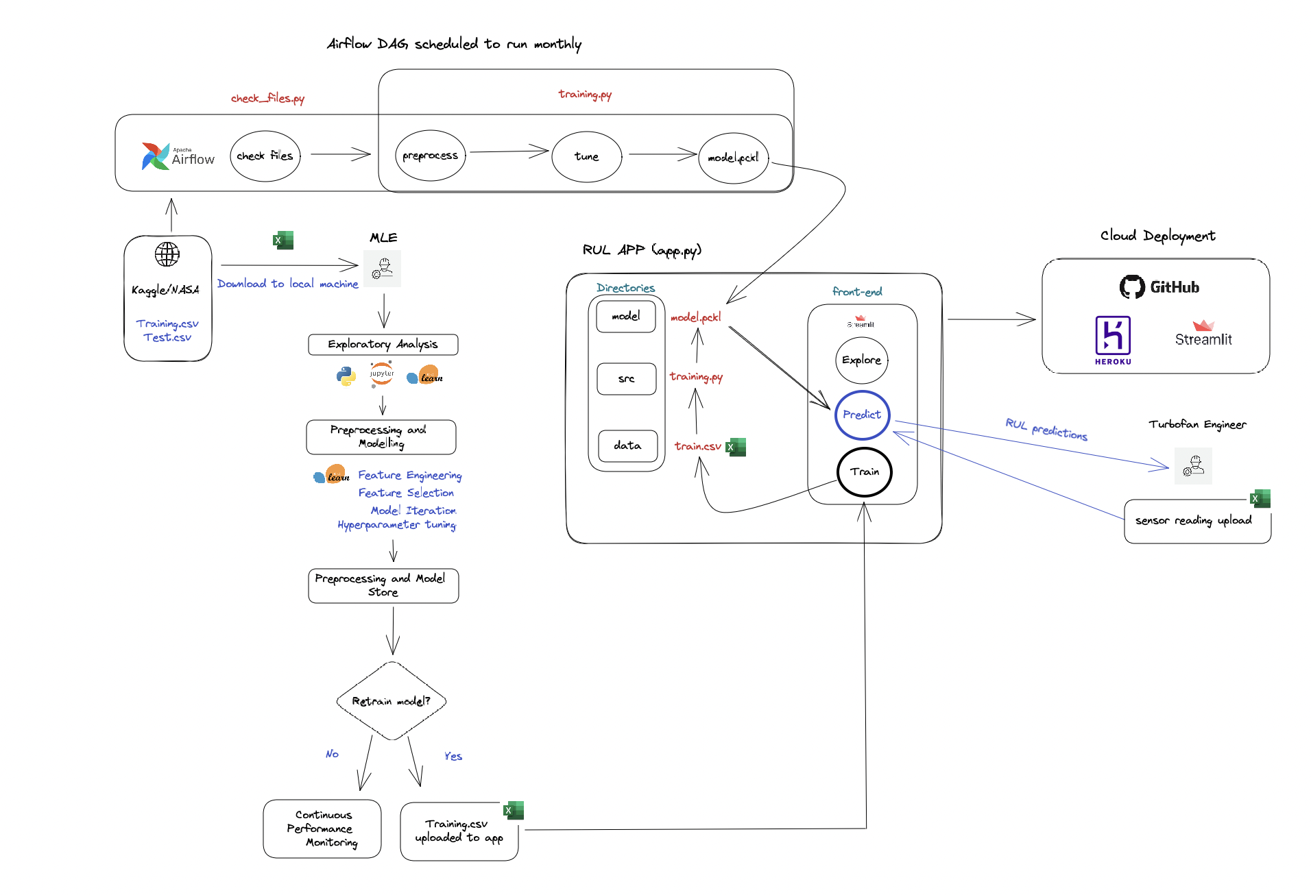
INFRASTRUCTURE DIAGRAM
https://excalidraw.com/#json=g9RBQNyOCyXaJiW1QyLsY,kcjMP5_OhWzlYWk45xgQaQ

Slide 3
MODEL EXPLAINABILITY
One drawback of machine learning models is that they are inherently difficult to explain in terms of causality, i.e. what is the theoretical rationale for their parameter outputs in relation to the target response. Our best approach to help turbofan engineers understand predictions made by our model is to provide both a ‘global’ explanation and a ‘local’ one.
GLOBAL
LOCAL
This helps in understanding how a model makes decisions for the overall structure​
Global interpretation help in understanding the suitability of the model for deployment
In our case, how does the SVR model work, how were the hyperparameters calculated and what assumptions did we make in training
This helps in understanding how the model makes decisions for a single instance
Using local interpretation we can explain the individual predictions
In our case, for a single set of sensor readings, what sensors were the most influential in determining the prediction the SVR model made

Slide 4
MODEL EXPLAINABILITY LIBRARIES
SHAPLEY
ELI-5
TBD
TBD
TBD
TBD
https://www.analyticsvidhya.com/blog/2021/11/model-explainability/

Slide 5
SUMMARY
TBD

